Slide 1

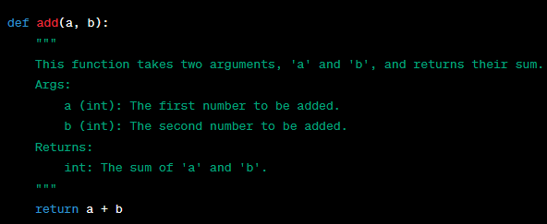
Python Basics for Machine Learning
Introduction
Python is a versatile and popular programming language widely used in the field of Machine Learning. This note covers fundamental Python concepts and essential libraries for anyone starting their journey in Machine Learning.
Comments
Comments in Python are used to add explanations or notes within your code to make it more readable and understandable for both yourself and others who may work with the code. Python provides two ways to add comments: single-line comments and multi-line comments (also known as docstrings).
A. Single-Line Comments: Single-line comments are used for adding short comments to a single line of code. You can create a single-line comment by using the '#' symbol. Everything following the '#' symbol on the same line is treated as a comment and is ignored by the Python interpreter.
Here's an example of a single-line comment:
B. Multi-Line Comments (Docstrings):
In Python, you can also create multi-line comments using docstrings.
Docstrings are typically used for documenting functions, classes, and modules.
They are enclosed in triple quotes (either single or double) and
can span multiple lines.
Unlike single-line comments, docstrings are used for documentation purposes and
can be accessed using the help() function.
Here's an example of a multi-line comment (docstring) for a function:
linkedin.com/in/debaprasann-b-033407115
Common Data Types

Slide 2
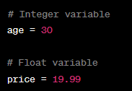


Python Basics for Machine Learning
2) Variables
In Python, variables are used to store and manage data. They are like containers that hold values, and can assign different types of data to variables, such as numbers, text, lists, or more complex data structures.
Numeric Variables: It can store numerical values in variables, such as integers and floating-point numbers.
Data Types
String Variables: It can use variables to store text data using strings.
List Variables: Lists allow you to store multiple values in a single variable.
Multiple Assignment: It can assign values to multiple variables in a single line.

Slide 3



Python Basics for Machine Learning
Dictionary Variables: Dictionaries are used to store key-value pairs.
Boolean Variables: It can use variables to store Boolean values (True or False) for conditions.
Variable Assignment: It can reassign values to variables at any time.
Constants: Although Python doesn't have true constants, it's a convention to use uppercase names for values that should not be changed.
Type Inference: Python is dynamically typed, meaning you don't need to specify the data type explicitly. Python infers the data type based on the assigned value.

Slide 4




Python Basics for Machine Learning
3) Data Types
Python has several built-in data types to store and manipulate different kinds of data. Here's a brief overview of the most common data types in Python:
Integer (int):
Used to represent whole numbers (positive or negative).
Example: x = 5
Floating-Point Number (float):
Used to represent numbers with decimal points.
Example: y = 3.14
String (str):
Used to represent text or sequences of characters.
Example: name = "Alice“
Boolean (bool):
Represents either True or False.
Example: is valid = True

Slide 5






Python Basics for Machine Learning
List:
Ordered collection of items that can be of different data types.
Example: fruits = ["apple", "banana", "cherry"]
Tuple:
Similar to lists but immutable (cannot be changed once created).
Example: coordinates = (3, 4)
Dictionary (dict):
Stores data as key-value pairs.
Example: person = {"name": "Bob", "age": 30}
Set:
An unordered collection of unique elements.
Example: unique numbers = {1, 2, 3, 4, 5}
None Type (None):
Represents the absence of a value or a null value.
Example: result = None
Complex Number (complex):
Used to represent numbers with real and imaginary parts.
Example: z = 3 + 4j

Slide 6



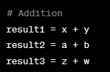
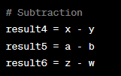


Python Basics for Machine Learning
3) Python Numbers
In Python, there are three main types of numbers: integers, floating-point numbers, and complex numbers.
Integers (int): Integers are whole numbers without a decimal point. They can be positive or negative.
Floating-Point Numbers (float): Floating-point numbers are numbers with a decimal point, and they can also be positive or negative. Python uses the float data type to represent them.
Complex Numbers (complex): Complex numbers have both a real part and an imaginary part. They are written in the form a + bj, where "a" is the real part and "b" is the imaginary part. Python uses the j or J to represent the imaginary unit.
Also can perform various arithmetic operations with these numbers,
such as addition, subtraction, multiplication, and division.
Here are some examples:

Slide 7




Python Basics for Machine Learning
4) Casting
Casting in Python refers to the process of changing the data type of a variable or value from one type to another. This can be useful when you want to perform operations that are only allowed for specific data types or when you need to ensure that a value is of a certain type. Python provides several casting functions to achieve this.
Integer Casting (int()): You can convert a value to an integer using the int() function. This will truncate any decimal part and convert the value to an integer.
Float Casting (float()): You can convert a value to a floating-point number using the float() function. This will add a decimal point to the integer value, or it can convert a string representing a number to a float.
String Casting (str()): You can convert a value to a string using the str() function. This is useful when you want to concatenate a non-string value with other strings.
List Casting (list()): You can convert an iterable, like a tuple or a string, to a list using the list() function.

Slide 8




Python Basics for Machine Learning
Tuple Casting (tuple()): You can convert an iterable to a tuple using the tuple() function.
Boolean Casting (bool()): You can convert a value to a Boolean using the bool() function. In Python, most values can be converted to either True or False.
Set Casting (set()): You can convert a list or another iterable to a set using the set() function. This removes duplicates and returns an unordered collection of unique elements.
Dictionary Casting (dict()): You can convert a list of key-value pairs (as tuples) to a dictionary using the dict() function.

Slide 9
Python Basics for Machine Learning
Tuple Casting (tuple()): You can convert an iterable to a tuple using the tuple() function.
Boolean Casting (bool()): You can convert a value to a Boolean using the bool() function. In Python, most values can be converted to either True or False.
Set Casting (set()): You can convert a list or another iterable to a set using the set() function. This removes duplicates and returns an unordered collection of unique elements.
Dictionary Casting (dict()): You can convert a list of key-value pairs (as tuples) to a dictionary using the dict() function.

Slide 10

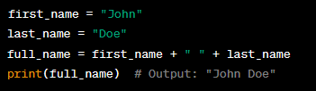


Python Basics for Machine Learning
5) Python Strings
In Python, a string is a sequence of characters enclosed in either single (''), double ("") or triple (''' or """) quotation marks.
Creating Strings: You can create strings by enclosing text in single, double, or triple quotation marks. For example:
String Concatenation: You can concatenate strings using the + operator. For example:
String Length: You can find the length of a string using the len() function. For example:
Accessing Characters: You can access individual characters in a string using indexing.
Python uses 0-based indexing, where the first character is at index 0. For example:

Slide 11

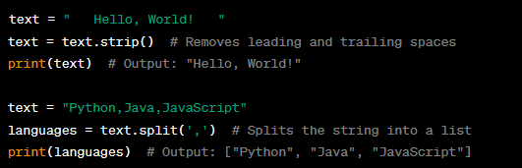

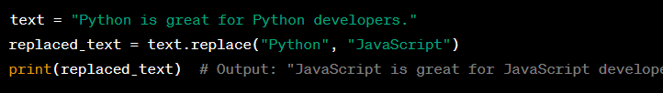
Python Basics for Machine Learning
Slicing Strings: You can extract a portion of a string using slicing. For example:
String Methods: Python provides many built-in methods for working with
strings, such as upper(), lower(), strip(), split(), and more.
For example:
String Formatting: You can format strings using various techniques, including f-strings, the .format() method, and the % operator.
For example:
String Methods for Manipulation: There are numerous string methods for manipulation, such as replace(), find(), count(), startswith(), endswith(), and more.
For example:

Slide 12
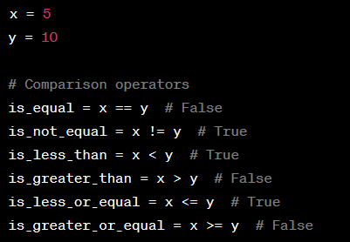
Python Basics for Machine Learning
6) Python Booleans
Booleans in Python represent the two truth values, True and False. They are fundamental data types that are used for making logical decisions and controlling the flow of a program.
Boolean Values:
True: Represents a true or positive condition.
False: Represents a false or negative condition.
Comparison Operators: You can use comparison operators to compare values and create Boolean expressions.
== (equal to): Checks if two values are equal.
!= (not equal to): Checks if two values are not equal.
< (less than): Checks if one value is less than another.
> (greater than): Checks if one value is greater than another.
<= (less than or equal to): Checks if one value is less than or equal to another.
>= (greater than or equal to): Checks if one value is greater than or equal to another.

Slide 13
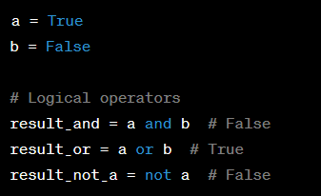
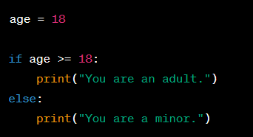
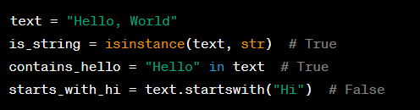
Python Basics for Machine Learning
Logical Operators:
You can use logical operators to combine or modify Boolean values.
and: Returns True if both operands are True.
or: Returns True if at least one operand is True.
not: Returns the opposite Boolean value (negation).
Conditional Statements: Booleans are often used in conditional statements to control the flow of a program.
Functions that return Booleans:
Many built-in functions in Python return Boolean values,
such as isinstance(), in, and startswith.

Slide 14




Python Basics for Machine Learning
7) Python Operators
Python operators are special symbols or keywords that are used to perform operations on variables and values. They can be categorized into various types, including arithmetic operators, comparison operators, logical operators, assignment operators, and more.
Arithmetic Operators:
Addition (+): Adds two numbers.
Subtraction (-): Subtracts the second number from the first..
Multiplication (*): Multiplies two numbers
Division (/): Divides the first number by the second, returning a float..

Slide 15



Python Basics for Machine Learning
Floor Division (//): Divides the first number by the second, returning an integer (floor division).
Modulus (%): Returns the remainder of the division of the first number by the second.
Exponentiation (**): Raises the first number to the power of the second.

Slide 16
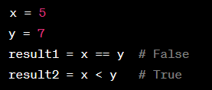
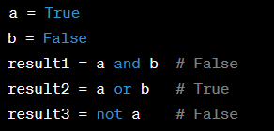
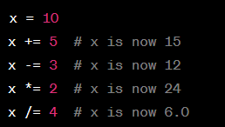
Python Basics for Machine Learning
Comparison Operators:
Equal to (==): Checks if two values are equal.
Not equal to (!=): Checks if two values are not equal.
Greater than (>): Checks if the first value is greater than the second.
Less than (<): Checks if the first value is less than the second.
Greater than or equal to (>=): Checks if the first value is greater than or equal to the second.
Less than or equal to (<=): Checks if the first value is less than or equal to the second.
Logical Operators:
and: Returns True if both conditions are true.
or: Returns True if at least one condition is true.
not: Returns the opposite of the condition.
Assignment Operators:
=: Assigns a value to a variable.
+=: Adds and assigns the right operand to the left operand.
-=: Subtracts and assigns the right operand to the left operand.
*=: Multiplies and assigns the right operand to the left operand.
/=: Divides and assigns the right operand to the left operand.

Slide 17
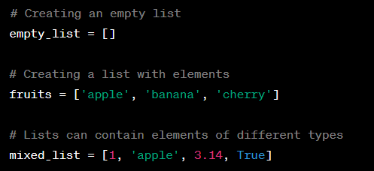
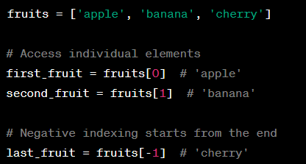
Python Basics for Machine Learning
8) Python List
In Python, a list is a data structure that allows you to store and manage a collection of items, such as numbers, strings, or objects. Lists are ordered, mutable (you can change their content), and can contain elements of different types. You can create a list by enclosing a comma-separated sequence of items within square brackets [].
Example:
Accessing Elements:
You can access elements in a list by their index,
starting from 0 for the first element.

Slide 18
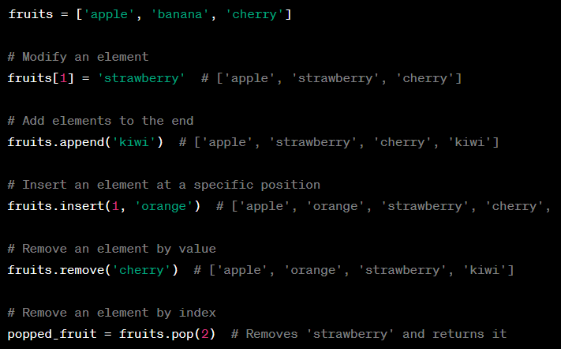
Python Basics for Machine Learning
Modifying Lists:
You can modify lists by assigning new values to specific indices, adding, or removing elements.

Slide 19
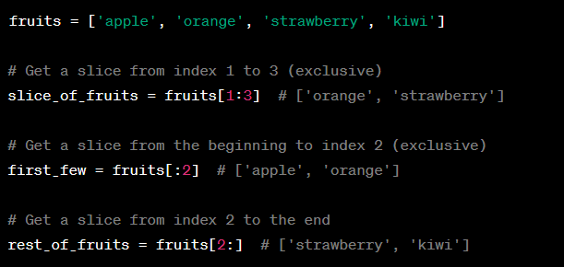
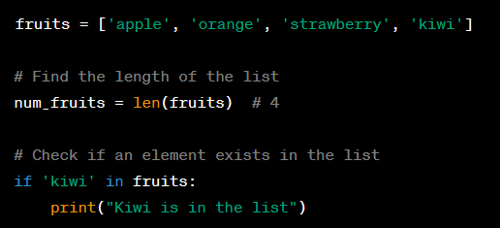
Python Basics for Machine Learning
List Slicing:
You can extract a portion of a list using slicing.
Common List Operations:
Here are some common operations on lists:

Slide 20




Python Basics for Machine Learning
9) Python Tuple
A tuple in Python is an ordered collection of elements enclosed within parentheses (). Tuples are similar to lists, but they are immutable, meaning their elements cannot be changed after creation.
Creating a Tuple
You can create a tuple by enclosing a sequence of elements within parentheses. The elements can be of any data type, and you can mix data types within a tuple.
Accessing Elements
You can access individual elements of a tuple using indexing, just like with lists. Indexing starts at 0 for the first element
Slicing
You can slice a tuple to create a new tuple with a subset of its elements. Slicing is done using the colon (:) notation.

Slide 21
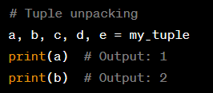

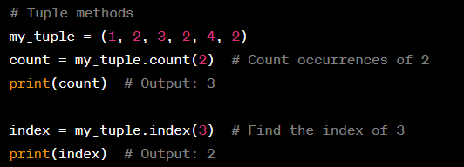

Python Basics for Machine Learning
Tuple Unpacking
Tuple unpacking is a way to assign the elements of a tuple to individual variables.
Immutable Nature
Tuples are immutable, so you cannot modify their elements. Once a tuple is created, you can't change, add, or remove elements from it.
Tuple Methods
Tuples have a few methods, such as count and index, which allow you to count occurrences of an element and find the index of a specific value, respectively.

Slide 22
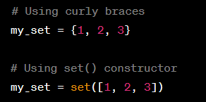

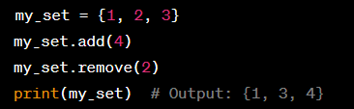
Python Basics for Machine Learning
10) Python Set
A Python set is an unordered collection of unique elements. Sets are defined using curly braces {} or the set() constructor, and they can contain a variety of data types such as numbers, strings, and even other sets.
Creating a Set: You can create a set by enclosing a comma-separated sequence of elements within curly braces {} or by using the set() constructor.
Unique Elements: Sets only store unique elements. Duplicates are automatically removed.
Adding and Removing Elements: You can add elements to a set using the add() method and remove elements using the remove() or discard() method.

Slide 23
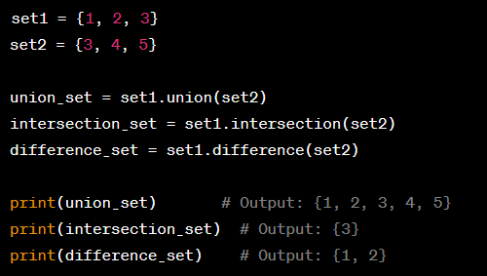



Python Basics for Machine Learning
Set Operations: You can perform various set operations, such as union, intersection, and difference using methods like union(), intersection(), and difference().
Set Comprehensions: Membership Test:
Length of a Set:

Slide 24
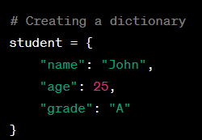


Python Basics for Machine Learning
11) Python Dictionaries
A dictionary in Python is a built-in data structure that stores a collection of key-value pairs. It is also sometimes referred to as a "hash map" or "associative array" in other programming languages. Dictionaries are mutable, unordered, and iterable. Each key in a dictionary is unique and associated with a corresponding value. You can use dictionaries to store and retrieve data in a way that is efficient and convenient.
Creating a Dictionary
You can create a dictionary using curly braces {} and providing key-value pairs separated by colons :.
Accessing Values
You can access the values in a dictionary by specifying the key in square brackets [] or by using the .get() method.
Modifying Values
You can change the value associated with a key by simply assigning a new value to it.

Slide 25



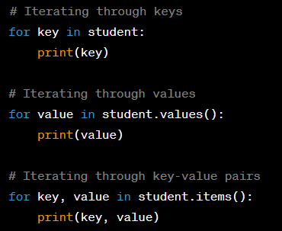

Python Basics for Machine Learning
Adding Key-Value Pairs Removing Key-Value Pairs
Checking for Key Existence Dictionary Methods
Python dictionaries come with several useful method including:
keys(): Returns a list of all keys in the dictionary.
values(): Returns a list of all values in the dictionary.
items(): Returns a list of key-value pairs (tuples) in the.
Iterating Through a Dictionary :

Slide 26


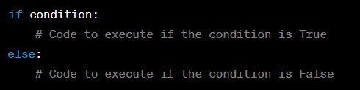
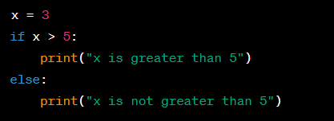
Python Basics for Machine Learning
12) Python If Else Statement
In Python, the if and else statements are used for conditional branching, allowing you to execute different blocks of code based on whether a certain condition is True or False.
The if Statement:
The if statement is used to check a condition, and if that condition is true, the code block inside the if statement is executed. If the condition is false, the code block is skipped.
condition: A Boolean expression that is evaluated as True or False. In the below example, the code block inside the if statement will be executed because x is indeed greater than 5.
The else Statement:
The else statement is used in combination with the if statement. It allows you to specify a code block that will be executed if the if condition is False.
Example 2:

Slide 27
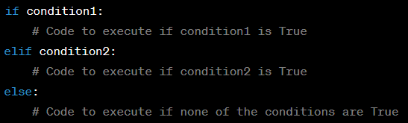
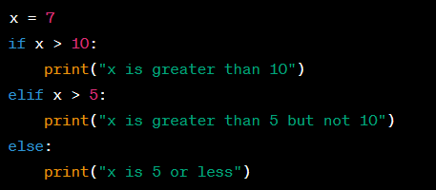
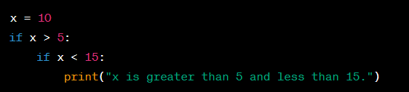
Python Basics for Machine Learning
if...elif...else Statements:
You can also use the elif (short for "else if") statement to handle multiple conditions in a sequence. The elif statement is used when you want to check multiple conditions in order, and the first true condition found will execute its corresponding block of code.
Example 3:
Nesting if Statements:
You can nest if statements inside other if, else, or elif blocks to create more complex conditional logic.

Slide 28

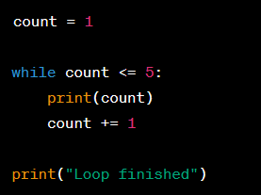
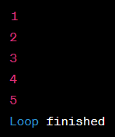
Python Basics for Machine Learning
13) Python While loop
A while loop in Python is used to repeatedly execute a block of code as long as a certain condition remains true. The loop will continue to execute as long as the condition is evaluated to be True.
Here's how it works:
The condition is evaluated before the loop body is executed.
If the condition is True, the code inside the loop body is executed.
After the loop body is executed, the condition is checked again.
If the condition is still True, the loop body is executed again, and this process continues until the condition becomes False.
Once the condition becomes False, the loop terminates, and the program continues with the next statement after the loop.
Output:

Slide 29
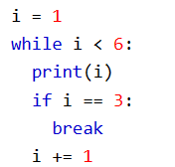
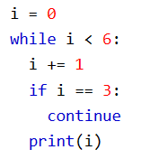
Python Basics for Machine Learning
The break Statement
With the break statement we can stop the loop even if the while condition is true:
Exit the loop when I is 3.
The continue Statement
With the continue statement we can stop the current iteration, and continue with the next:
Continue to the next iteration if i is 3:

Slide 30






Python Basics for Machine Learning
14) Python For loop
A for loop in Python is used to iterate over a sequence (such as a list, tuple, string, or range) or any iterable object. It repeatedly executes a block of code for each item in the sequence until the sequence is exhausted.
Iterating over a List:
You can use a for loop to iterate over the elements in a list. O/P:
Iterating over a Range:
You can use the range() function to generate a sequence of numbers and then iterate over them.
o/p:
Iterating over a String:
o/p:

Slide 31


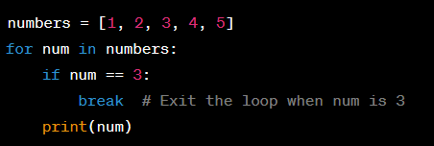

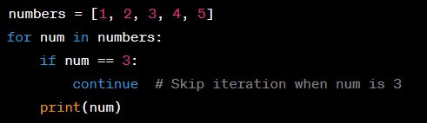

Python Basics for Machine Learning
Nested ‘For’ Loops:
You can use nested for loops to iterate over multiple sequences or create patterns.
o/p:
Using ‘break’ and ‘continue’:
You can use break to exit the loop prematurely and continue to skip the current iteration and move to the next one.
o/p:
o/p:

Slide 32




Python Basics for Machine Learning
15) Python Functions
Functions in Python are blocks of reusable code that perform a specific task or a set of tasks. They are essential for organizing and managing your code, making it more modular and readable. In Python, you can create your own functions using the def keyword.
Function Definition: You define a function using the def keyword followed by the function name and a set of parentheses, which may include parameters. The function's code block is indented.
Function Parameters: Functions can accept input values, known as parameters or arguments. Parameters are defined within the parentheses in the function definition.
Function Return: Functions can return values using the return statement. If a function doesn't have a return statement, it returns None by default.
Function Invocation: To use a function, you call it by its name and provide values for its parameters in the same order they are defined.

Slide 33
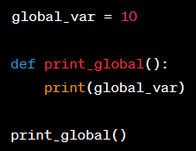
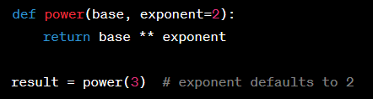

Python Basics for Machine Learning
Function Scope: Variables defined within a function are local to that function and cannot be accessed outside of it. Global variables can be accessed from within a function using the global keyword.
Default Arguments: You can provide default values for function parameters. These default values are used if the caller doesn't specify a value for that parameter.
Lambda Functions: Lambda functions are anonymous functions defined using the lambda keyword. They are typically used for simple, one-liner operations.

Slide 34
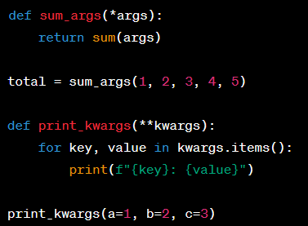
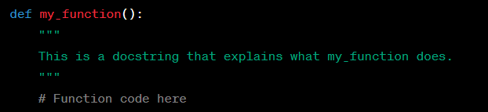
Python Basics for Machine Learning
Variable-Length Arguments: You can define functions that accept a variable number of arguments using *args and **kwargs. *args represents a tuple of positional arguments, and **kwargs represents a dictionary of keyword arguments.
Docstrings: It's good practice to provide documentation for your functions using docstrings. Docstrings are enclosed in triple-quotes and provide information about the function's purpose and usage.

Slide 35
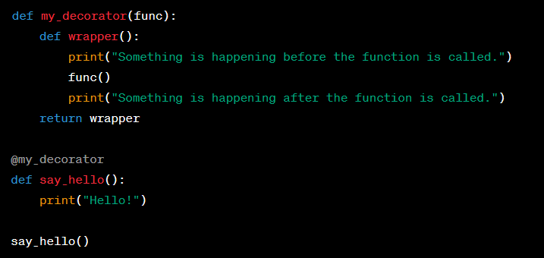
Python Basics for Machine Learning
Function Decorators: Function decorators are used to modify or extend the behavior of functions. They are typically used with the @ symbol above the function definition.

Slide 36


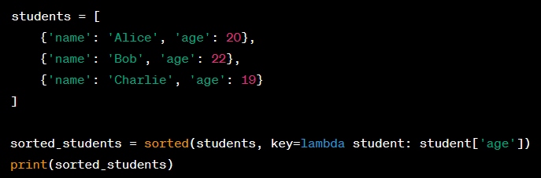
Python Basics for Machine Learning
16) Python Functions
A lambda function in Python is an anonymous, small, and inline function that can have any number of arguments but can only have one expression. Lambda functions are often used for short and simple operations. They are created using the lambda keyword. Here's the basic syntax of a lambda function:
Simple Lambda Function:
Sorting with Lambda Function:
Lambda functions are often used with functions like sorted() to specify custom sorting keys. For instance, you can sort a list of dictionaries by a specific key:

Slide 37
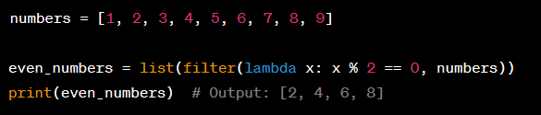
Python Basics for Machine Learning
Filtering with Lambda Function:
You can use lambda functions with functions like filter() to filter elements based on a condition:
This code uses a lambda function to filter out even numbers from the numbers list.

Slide 38

Python Basics for Machine Learning
16) Python Array
In Python, you can create arrays using various data structures. One of the most commonly used data structures for creating arrays is the "list." Lists in Python are ordered collections of items that can be of different data types.
Creating an Array (List):
You can create an array (list) by enclosing elements in square brackets []. Elements can be of any data type, including numbers, strings, or even other lists.
Accessing Elements:
You can access elements in the array using their index, starting from 0 for the first element.
Modifying Elements:
You can modify elements in the array by assigning new values to specific indices.
Adding Elements:
You can add elements to the end of the array using the append method.

Slide 39


Python Basics for Machine Learning
Removing Elements:
You can remove elements from the array using the remove method or the del statement
Array Slicing:
You can extract a portion of the array using slicing. This is done by specifying a start and end index (not inclusive).
Array Length:
You can find the length of an array using the len() function.
Iterating Through an Array:
You can use loops to iterate through the elements of an array.

Slide 40


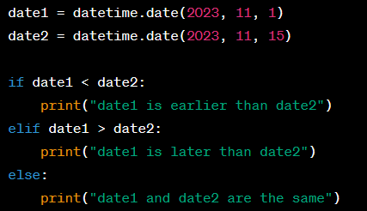
Python Basics for Machine Learning
16) Python Dates
Working with dates in Python is a common task, and the datetime module is the standard library module used for this purpose.
# Getting the current date and time
# Creating a specific date
# Comparing dates

Slide 41
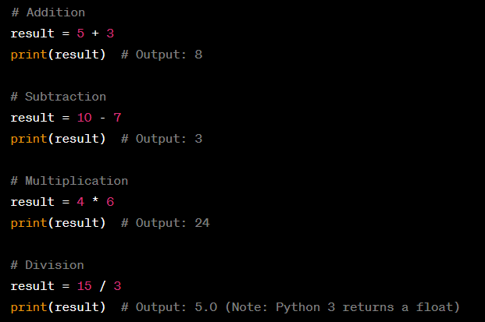
Python Basics for Machine Learning
17) Python Maths
Python is a versatile programming language that includes a wide range of mathematical operations and functions.
Basic Arithmetic Operations: You can perform basic arithmetic operations in Python, such as addition, subtraction, multiplication, and division.

Slide 42

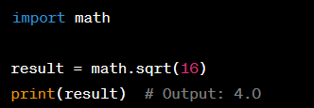
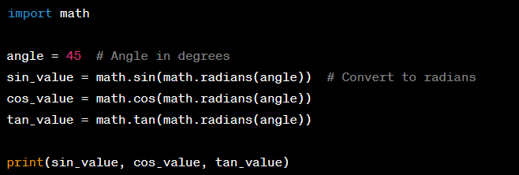

Python Basics for Machine Learning
Exponents and Powers:
Square Root:
Trigonometric Functions:
Absolute Value:

Slide 43
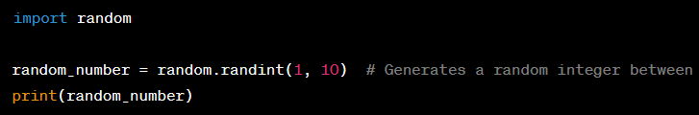
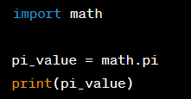
Python Basics for Machine Learning
Random Numbers:
Mathematical Constants: Python's math module also provides access to mathematical constants like pi.

